Slide 1

DIGITAL LOGIC DESIGN (111776)
Dr. Owais Hussain

Slide 2

Agenda
Laws of Boolean Algebra
De’ Morgan’s Theorem
Sum of Product
Product of Sum
Minterms and Maxterms
Exercise – Piecing it together
Quiz

Slide 3
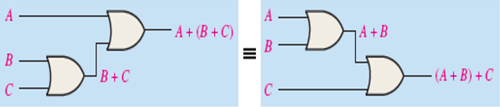
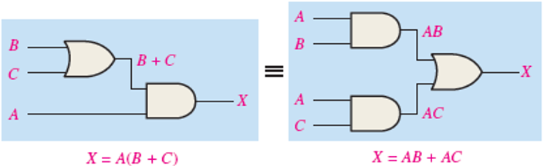
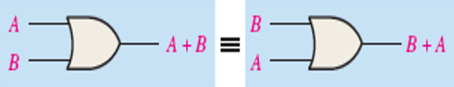
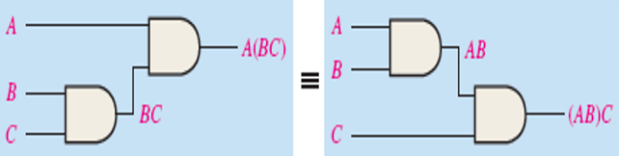

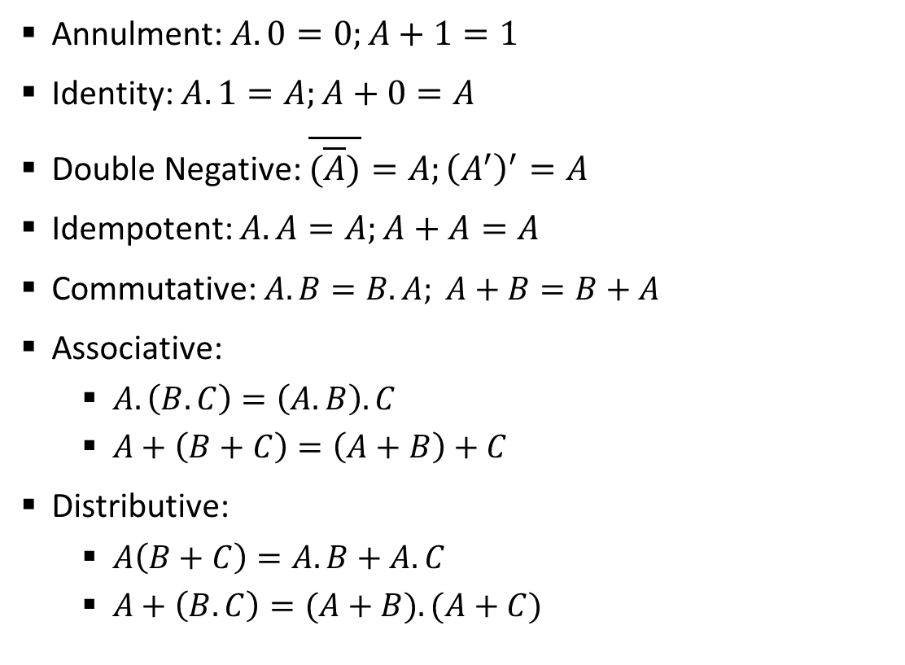
Sample 2
Laws of Boolean Algebra
Annulment: $A.0=0;A+1=1$
Identity: $A.1=A;A+0=A$
Double Negative: $\overline{(\overline{A})}=A;{\left(A^{′}\right)}^{′}=A$
Idempotent: $A.A=A;A+A=A$
Commutative: $A.B=B.A; A+B=B+A$
Associative:
$A.\left(B.C\right)=\left(A.B\right).C$
$A+\left(B+C\right)=\left(A+B\right)+C$
Distributive:
$A\left(B+C\right)=A.B+A.C$
$A+\left(B.C\right)=(A+B).(A+C)$
Notes:
Commutative law: Order makes no difference
Associative law: If the operation is same for 3 or more variables, then it doesn’t matter which one is performed first
Distributive law: For AND and OR, boolean equation can be expanded and simplified like algebraic equations

Slide 4
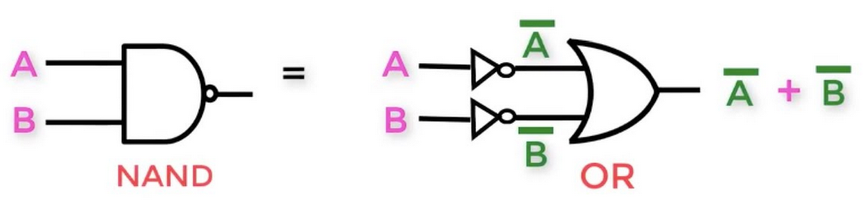
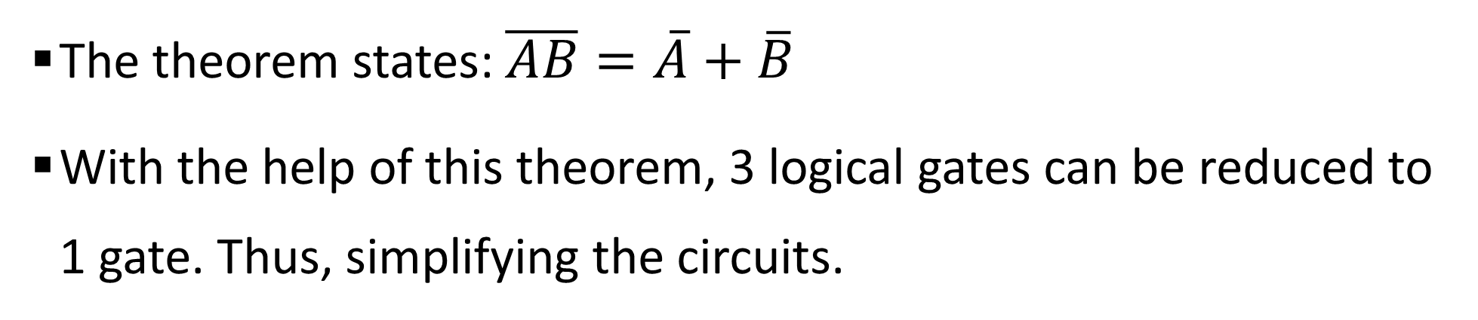
Sample 2
De’ Morgan’s Theorem
The theorem states: $\overline{AB}=\overline{A}+\overline{B}$
With the help of this theorem, 3 logical gates can be reduced to 1 gate. Thus, simplifying the circuits.

Slide 5
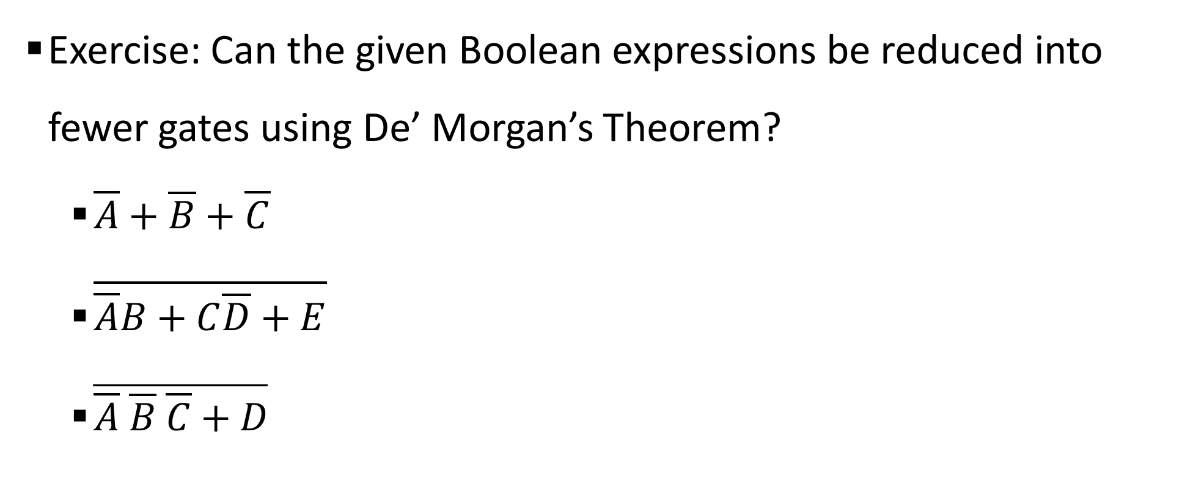
Sample 2
De’ Morgan’s Theorem
Exercise: Can the given Boolean expressions be reduced into fewer gates using De’ Morgan’s Theorem?
$\overline{A}+\overline{B}+\overline{C}$
$\overline{\overline{A}B+C\overline{D}+E}$
$\overline{\overline{A} \overline{B} \overline{C}+D}$
Notes:
$\overline{A}+\overline{B}+\overline{C}$=$\overline{AB}+\overline{C}=\overline{ABC}$
$\overline{\overline{A}B+C\overline{D}+E}$=$\overline{\overline{A}B}.\overline{C\overline{D}}.\overline{E}=(A+\overline{B})(\overline{B}+D)(\overline{E})$

Slide 6
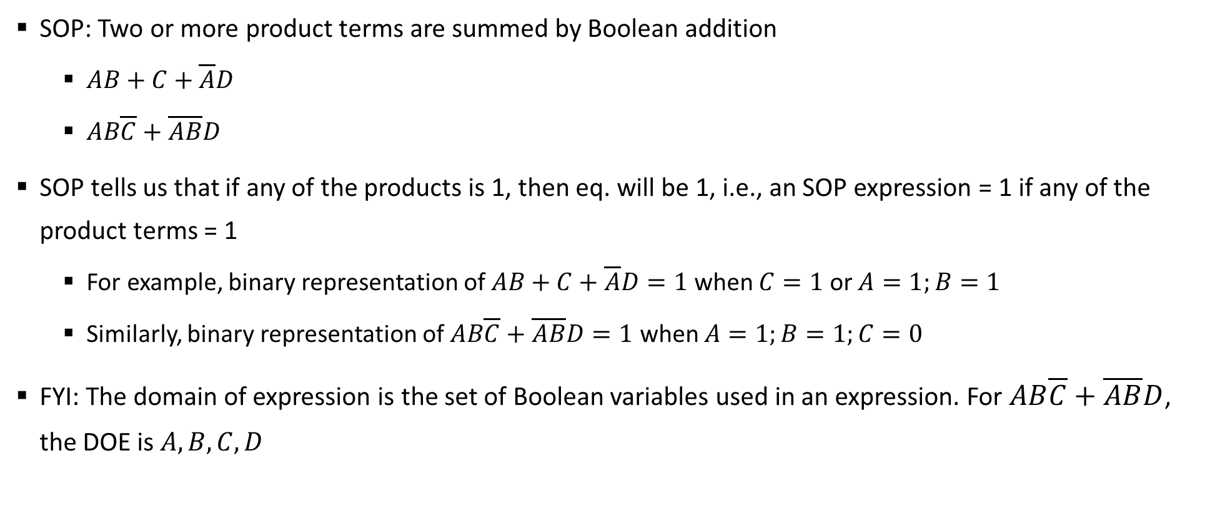
Sample 2
Sum of Product
SOP: Two or more product terms are summed by Boolean addition
$AB+C+\overline{A}D$
$AB\overline{C}+\overline{AB}D$
SOP tells us that if any of the products is 1, then eq. will be 1, i.e., an SOP expression = 1 if any of the product terms = 1
For example, binary representation of $AB+C+\overline{A}D=1$ when $C=1$ or $A=1;B=1$
Similarly, binary representation of $AB\overline{C}+\overline{AB}D=1$ when $A=1;B=1;C=0$
FYI: The domain of expression is the set of Boolean variables used in an expression. For $AB\overline{C}+\overline{AB}D$, the DOE is $A,B,C,D$
Notes:
Class exercise: Create truth table of $AB+C+\overline{A}D$

Slide 7
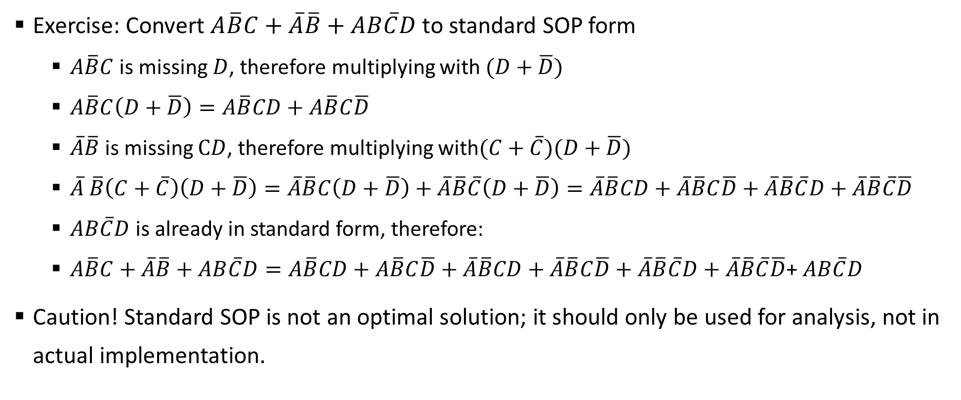
Sample 2
Sum of Product
Exercise: Convert $A\overline{B}C+\overline{A}\overline{B}+AB\overline{C}D$ to standard SOP form
$A\overline{B}C$ is missing $D$, therefore multiplying with $(D+\overline{D})$
$A\overline{B}C\left(D+\overline{D}\right)=A\overline{B}CD+A\overline{B}C\overline{D}$
$\overline{A}\overline{B}$is missing $CD$, therefore multiplying with$(C+\overline{C})(D+\overline{D})$
$\overline{A} \overline{B}\left(C+\overline{C}\right)\left(D+\overline{D}\right)=\overline{A}\overline{B}C\left(D+\overline{D}\right)+\overline{A}\overline{B}\overline{C}\left(D+\overline{D}\right)=\overline{A}\overline{B}CD+\overline{A}\overline{B}C\overline{D}+\overline{A}\overline{B}\overline{C}D+\overline{A}\overline{B}\overline{C}\overline{D}$
$AB\overline{C}D$ is already in standard form, therefore:
$A\overline{B}C+\overline{A}\overline{B}+AB\overline{C}D=A\overline{B}CD+A\overline{B}C\overline{D}+\overline{A}\overline{B}CD+\overline{A}\overline{B}C\overline{D}+\overline{A}\overline{B}\overline{C}D+\overline{A}\overline{B}\overline{C}\overline{D}$+ $AB\overline{C}D$
Caution! Standard SOP is not an optimal solution; it should only be used for analysis, not in actual implementation.

Slide 8
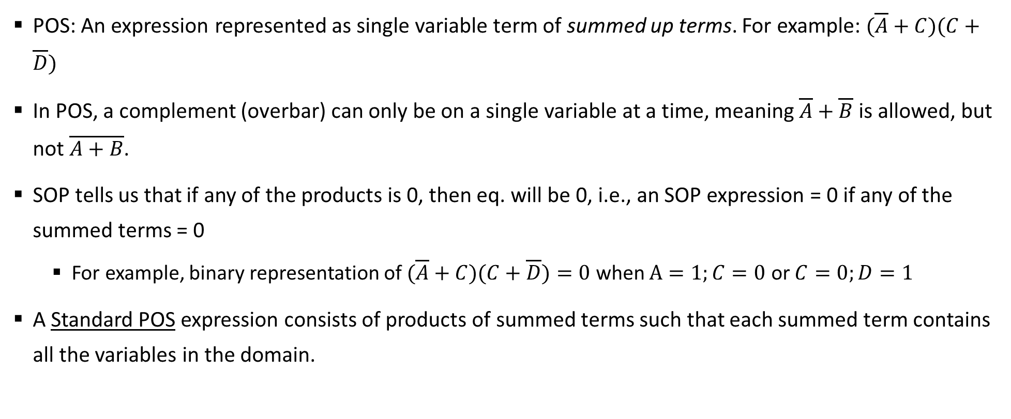
Sample 2
Product of Sum
POS: An expression represented as single variable term of summed up terms. For example: $(\overline{A}+C)(C+\overline{D})$
In POS, a complement (overbar) can only be on a single variable at a time, meaning $\overline{A}+\overline{B}$ is allowed, but not $\overline{A+B}$.
SOP tells us that if any of the products is 0, then eq. will be 0, i.e., an SOP expression = 0 if any of the summed terms = 0
For example, binary representation of $(\overline{A}+C)(C+\overline{D})=0$ when $A=1;C=0$ or $C=0;D=1$
A Standard POS expression consists of products of summed terms such that each summed term contains all the variables in the domain.
Notes:
Class exercise: create truth table of $(\overline{A}+C)(C+\overline{D})$

Slide 9
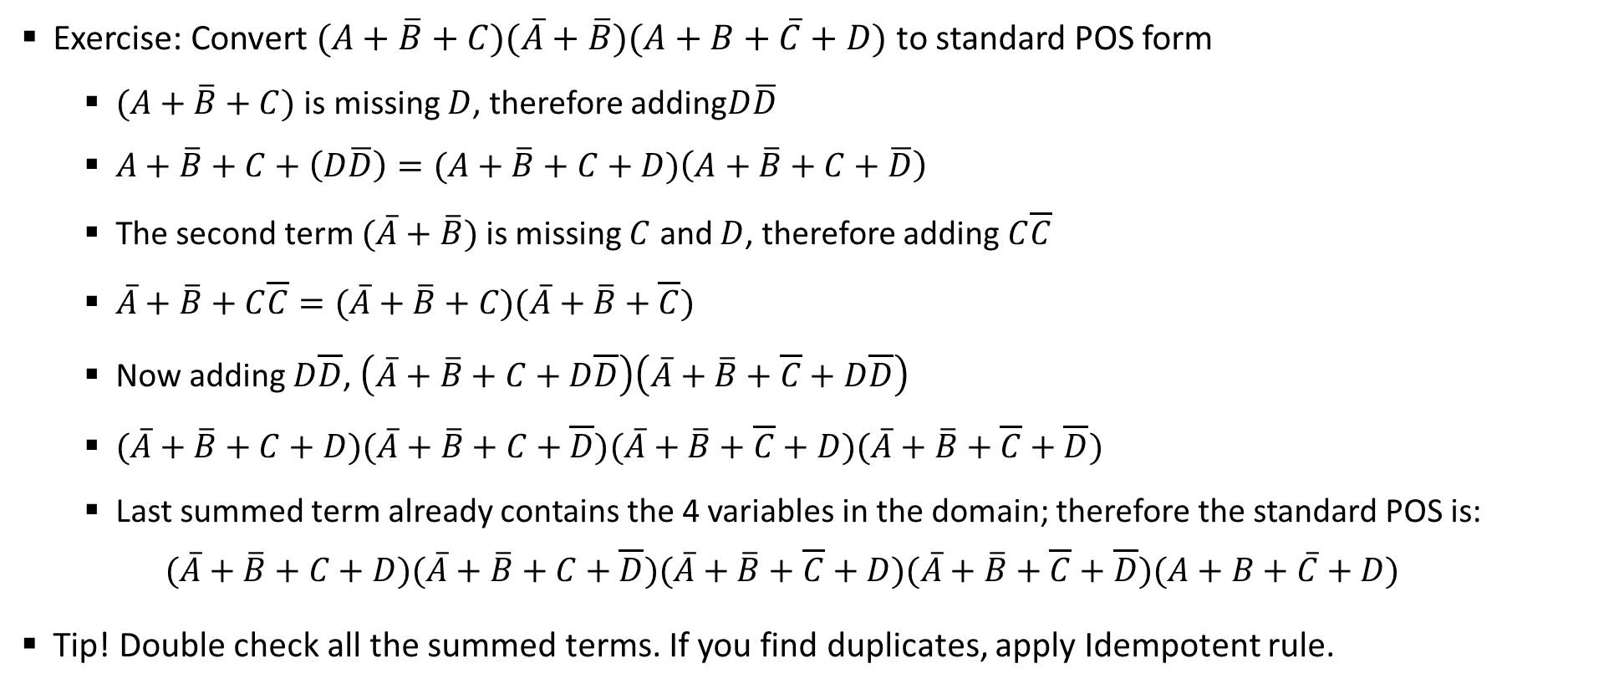
Sample 2
Product of Sum
Exercise: Convert $(A+\overline{B}+C)(\overline{A}+\overline{B})(A+B+\overline{C}+D)$ to standard POS form
$(A+\overline{B}+C)$ is missing $D$, therefore adding$D\overline{D}$
$A+\overline{B}+C+\left(D\overline{D}\right)=(A+\overline{B}+C+D)\left(A+\overline{B}+C+\overline{D}\right)$
The second term $(\overline{A}+\overline{B})$ is missing $C$ and $D$, therefore adding $C\overline{C}$
$\overline{A}+\overline{B}+C\overline{C}=(\overline{A}+\overline{B}+C)(\overline{A}+\overline{B}+\overline{C})$
Now adding $D\overline{D}$, $\left(\overline{A}+\overline{B}+C+D\overline{D}\right)\left(\overline{A}+\overline{B}+\overline{C}+D\overline{D}\right)$
$(\overline{A}+\overline{B}+C+D)(\overline{A}+\overline{B}+C+\overline{D})(\overline{A}+\overline{B}+\overline{C}+D)(\overline{A}+\overline{B}+\overline{C}+\overline{D})$
Last summed term already contains the 4 variables in the domain; therefore the standard POS is: $(\overline{A}+\overline{B}+C+D)(\overline{A}+\overline{B}+C+\overline{D})(\overline{A}+\overline{B}+\overline{C}+D)(\overline{A}+\overline{B}+\overline{C}+\overline{D})(A+B+\overline{C}+D)$
Tip! Double check all the summed terms. If you find duplicates, apply Idempotent rule.

Slide 10
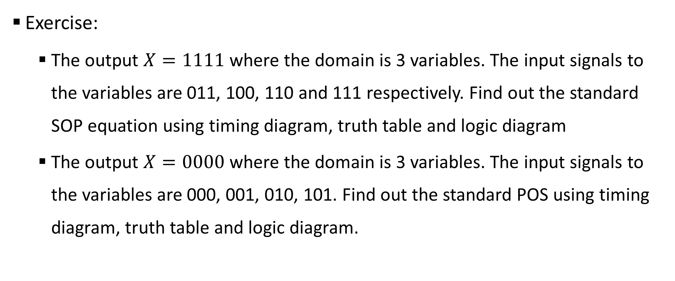
Sample 2
Binary to SOP and POS
Exercise:
The output $X=1111$ where the domain is 3 variables. The input signals to the variables are 011, 100, 110 and 111 respectively. Find out the standard SOP equation using timing diagram, truth table and logic diagram
The output $X=0000$ where the domain is 3 variables. The input signals to the variables are 000, 001, 010, 101. Find out the standard POS using timing diagram, truth table and logic diagram.

Slide 11
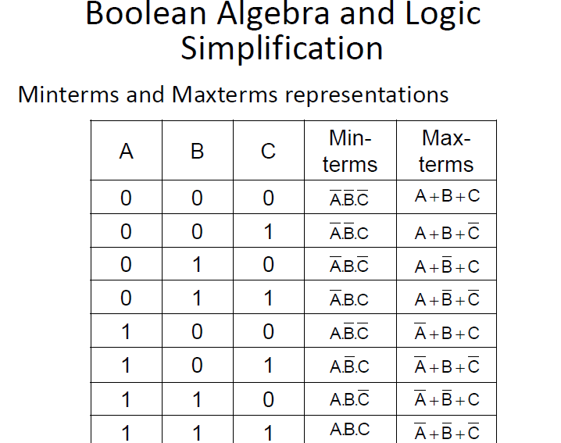
Sample 2
Minterms and Maxterms
Minterms and Maxterms are simply representations in Sum term or Product term

Slide 12
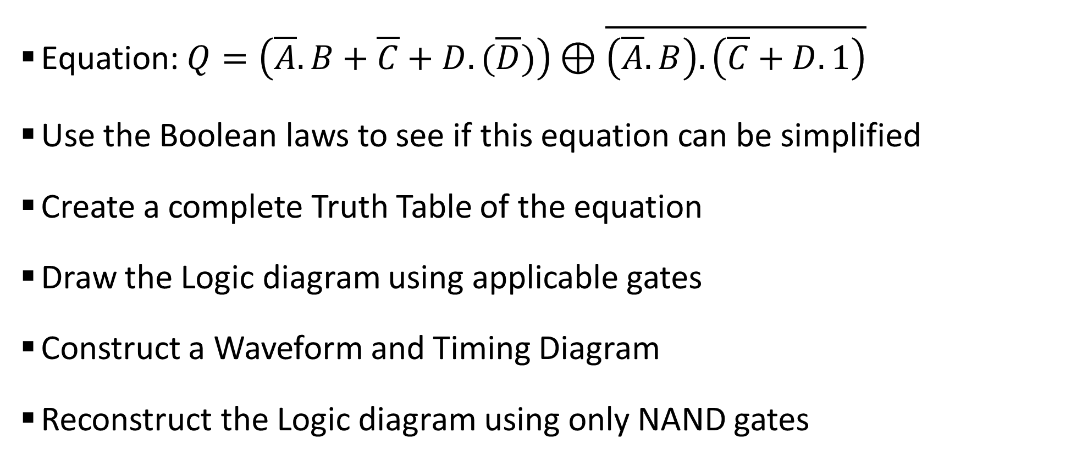
Sample 2
Exercise – Piecing it all Together
Equation: $Q=\left(\overline{A}.B+\overline{C}+D.(\overline{D})\right)⊕\overline{\left(\overline{A}.B\right).\left(\overline{C}+D.1\right)}$
Use the Boolean laws to see if this equation can be simplified
Create a complete Truth Table of the equation
Draw the Logic diagram using applicable gates
Construct a Waveform and Timing Diagram
Reconstruct the Logic diagram using only NAND gates

Slide 13
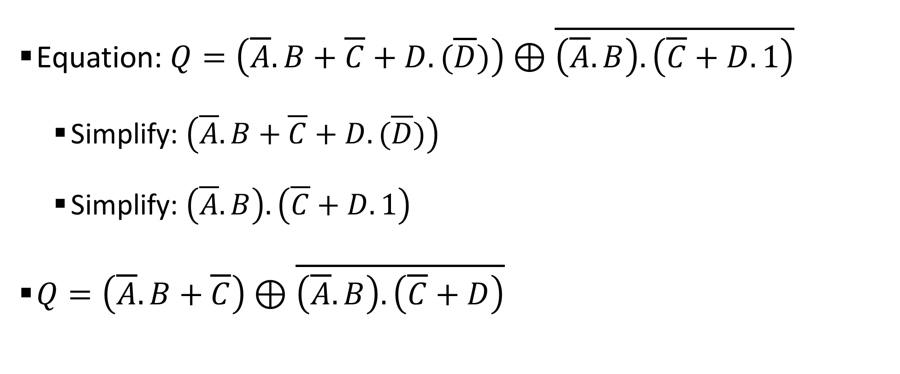
Sample 2
Exercise – Simplifying the equation
Equation: $Q=\left(\overline{A}.B+\overline{C}+D.(\overline{D})\right)⊕\overline{\left(\overline{A}.B\right).\left(\overline{C}+D.1\right)}$
Simplify: $\left(\overline{A}.B+\overline{C}+D.(\overline{D})\right)$
Simplify: $\left(\overline{A}.B\right).\left(\overline{C}+D.1\right)$
$Q=\left(\overline{A}.B+\overline{C}\right)⊕\overline{\left(\overline{A}.B\right).\left(\overline{C}+D\right)}$

Slide 14
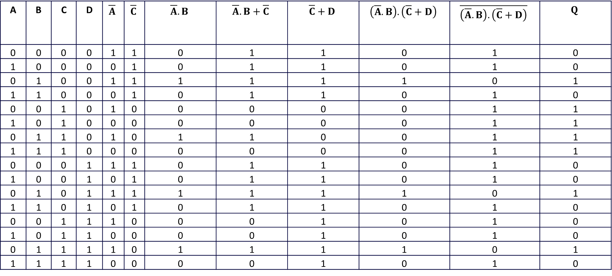
Sample 2
Exercise – Truth Table
A | B | C | D | $$\overline{A}$$ | $$\overline{C}$$ | $$\overline{A}.B$$ | $$\overline{A}.B+\overline{C}$$ | $$\overline{C}+D$$ | $$\left(\overline{A}.B\right).\left(\overline{C}+D\right)$$ | $$\overline{\left(\overline{A}.B\right).\left(\overline{C}+D\right)}$$ | $$Q$$
0 | 0 | 0 | 0 | 1 | 1 | 0 | 1 | 1 | 0 | 1 | 0
1 | 0 | 0 | 0 | 0 | 1 | 0 | 1 | 1 | 0 | 1 | 0
0 | 1 | 0 | 0 | 1 | 1 | 1 | 1 | 1 | 1 | 0 | 1
1 | 1 | 0 | 0 | 0 | 1 | 0 | 1 | 1 | 0 | 1 | 0
0 | 0 | 1 | 0 | 1 | 0 | 0 | 0 | 0 | 0 | 1 | 1
1 | 0 | 1 | 0 | 0 | 0 | 0 | 0 | 0 | 0 | 1 | 1
0 | 1 | 1 | 0 | 1 | 0 | 1 | 1 | 0 | 0 | 1 | 1
1 | 1 | 1 | 0 | 0 | 0 | 0 | 0 | 0 | 0 | 1 | 1
0 | 0 | 0 | 1 | 1 | 1 | 0 | 1 | 1 | 0 | 1 | 0
1 | 0 | 0 | 1 | 0 | 1 | 0 | 1 | 1 | 0 | 1 | 0
0 | 1 | 0 | 1 | 1 | 1 | 1 | 1 | 1 | 1 | 0 | 1
1 | 1 | 0 | 1 | 0 | 1 | 0 | 1 | 1 | 0 | 1 | 0
0 | 0 | 1 | 1 | 1 | 0 | 0 | 0 | 1 | 0 | 1 | 0
1 | 0 | 1 | 1 | 0 | 0 | 0 | 0 | 1 | 0 | 1 | 0
0 | 1 | 1 | 1 | 1 | 0 | 1 | 1 | 1 | 1 | 0 | 1
1 | 1 | 1 | 1 | 0 | 0 | 0 | 0 | 1 | 0 | 1 | 0

Slide 15
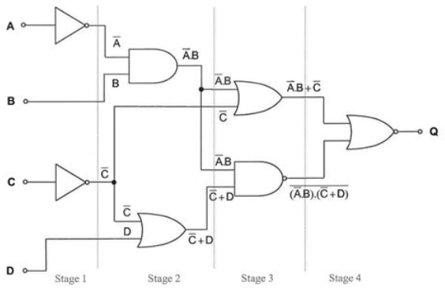
Sample 2
Exercise – Logic Diagram
Notes:
$D.(\overline{D})$=0, and should be removed
$D.1=D$

Slide 16
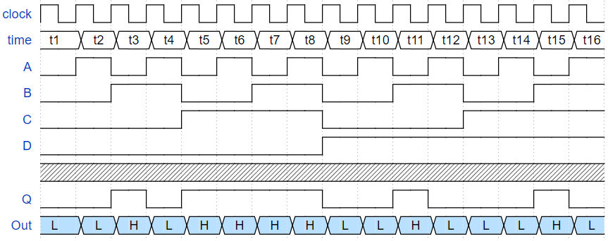
Sample 2
Exercise – Waveform
Notes:
$D.(\overline{D})$=0, and should be removed
$D.1=D$

Slide 17
Sample 2
DIY
Learn about Canonical Forms of Boolean expressions.
Create a 3-variable truth table with all possible input signals and write Minterms and Maxterms in Canonical form.

Slide 18



THANK YOU
Owais Hussain
+92 345-3174270
owais.hussain@kiet.edu.pk
https://www.researchgate.net/profile/Owais-Hussain-3

